Slide 1

AWS Global Infrastructure
Amazon Web Services is a global public cloud provider,
and as such, it has to have a global network of infrastructure
to run and manage its many growing cloud services that support
customers around the world.
The following components that make up the
AWS Global Infrastructure:
1. Availability Zones (Azs).
2. Regions.
3. Edge Locations.
4. Regional Edge Caches.

Slide 2
Availability Zones
Availability Zones and Regions are closely related.
AZs are essentially the physical data centers of AWS.
This is where the actual compute, storage, network, and
database resources are hosted that we as consumers provision
within our Virtual Private Clouds (VPCs).
A common misconception is that a single availability zone
is equal to a single data center. This is not the case.
In fact, it’s likely that multiple data centers located
close together to form a single availability zone.
Each AZ will always have at least one other AZ that is
geographically located within the same area, usually a city,
linked by highly resilient and very low latency private fiber
optic connections. However, each AZ will be isolated from the
others using separate power and network connectivity that
minimizes impact to other AZs should a single AZ fail.
This localized geographical grouping of multiple AZs,
which would include multiple data centers, is defined as an
AWS Region.

Slide 3
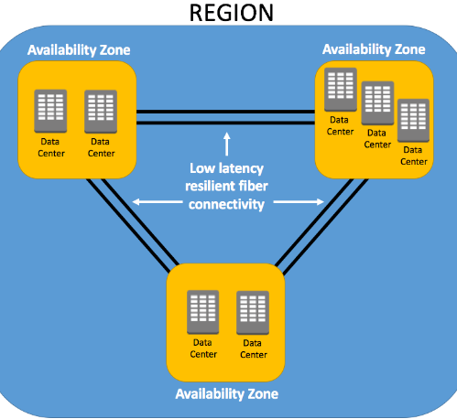

Slide 4
Regions
As we now know, a Region is a collection of availability zones
that are geographically located close to one other.
This is generally indicated by AZs within the same city.
AWS has deployed them across the globe to allow its worldwide
customer base to take advantage of low latency connections.
Every Region will act independently of the others, and each will
contain at least two Availability Zones.
For example,
if an organization based in London was serving customers
throughout Europe, there would be no logical sense to deploy
services in the Sydney Region simply due to the latency response
times for its customers.
Instead, the company would select the region most appropriate
for them and their customer base, which may be the London,
Frankfurt, or Ireland Region.
Similarly, You may want to use multiple regions if you are a
global organization serving customers in different countries
that have specific laws and governance about the use of data.
In this case, you could even connect different VPCs together in
different regions.

Slide 5
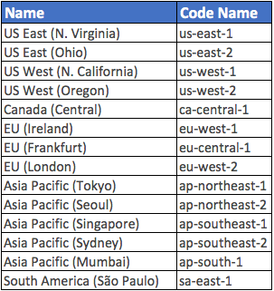
Region and Availability Zone Naming Conventions
AWS has a specific naming convention for both Regions and
Availability Zones.
This is generally indicated by AZs within the same city.
As you can see,
the name in the first column
is easier to associate to than
that of the Code Name.
Availability Zones are always
referenced by their Code Name,
which is defined by the AZs Region
Code Name that the AZ belongs to,
followed by a letter.
For example, the AZs within the
eu-west-1 region (EU Ireland),
are:
eu-west-1a
eu-west-1b
eu-west-1c

Slide 6
Edge Locations
Edge Locations are AWS sites deployed in major cities and highly
populated areas across the globe. They far outnumber the number
of availability zones available.
While Edge Locations are not used to deploy your main
infrastructures such as EC2 instances, EBS storage, VPCs, or
RDS resources like AZs, they are used by AWS services such as
AWS CloudFront and AWS Lambda@Edge (currently in Preview) to
cache data and reduce latency for end-user access by using the
Edge Locations as a global Content Delivery Network (CDN).
As a result, Edge Locations are primarily used by end users who
are accessing and using your services.
For example, you may have your website hosted on EC2 instances
and S3 (your origin) within the Ohio region with a configured
CloudFront distribution associated. When a user accesses your
website from Europe, they would be re-directed to their closest
Edge Location (in Europe) where cached data could be read on your
website, significantly reducing latency.

Slide 7
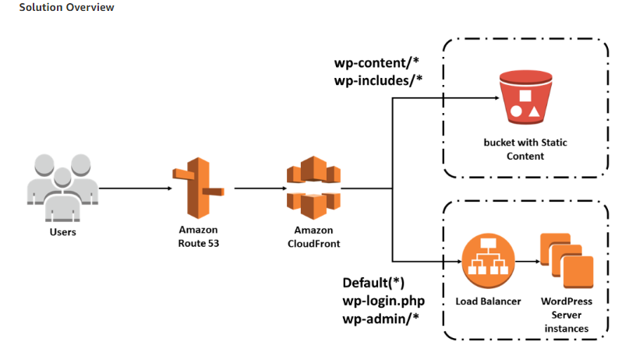

Slide 8
Regional Edge Cache
In November 2016, AWS announced a new type of Edge Location,
called a Regional Edge Cache.
A Regional Edge Cache has a larger cache-width than each of
the individual Edge Locations, and because data expires from the
Cache at the Edge Locations, the data is retained at the Regional
Edge Caches.
Therefore, when data is requested at the Edge Location that is no longer available,
the Edge Location can retrieve the cached data from the Regional Edge Cache
instead of the Origin servers, which would have a higher latency.
These sit between your CloudFront Origin servers and the
Edge Locations.

Slide 9
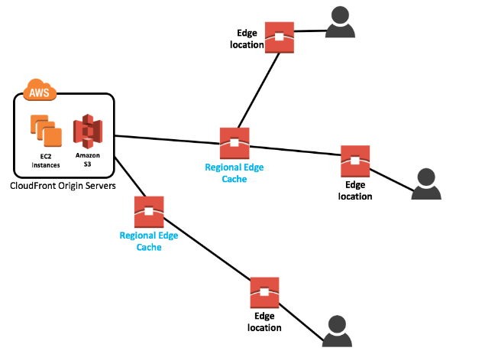

Slide 10
Thank you
https://cloudacademy.com/blog/aws-global-infrastructure/

